Slide 1
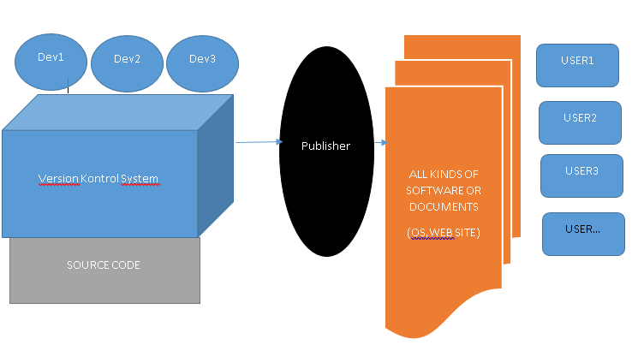
Version Control Protocols
What Is Version Control and Why Is it Important? Version control is important to keep track of changes — and keep every team member working on the right version. You should use version control software for all code, files, and assets that multiple team members will collaborate on.

Slide 2
Definitions
Repository, a data structure which stores metadata for a set of files or directory structure
Software repository, a storage location for software packages

Slide 3
Version Control Protocols
In software engineering, version control
also known as
revision control
source control
source code management
is a class of systems responsible for managing changes to computer programs, documents, large web sites, or other collections of information
Version control is a component of software configuration management.
In software engineering, software configuration management (SCM or S/W CM) is the task of tracking and controlling changes in the software, part of the larger cross-disciplinary field of configuration management.SCM practices include revision control and the establishment of baselines. If something goes wrong, SCM can determine the "what, when, why and who" of the change. If a configuration is working well, SCM can determine how to replicate it across many hosts.

Slide 4
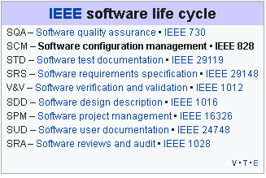
Position of Protocol
IEEE Software life cycle→SCM→Version Control
SCM
Configuration identification - Identifying configurations, configuration items and baselines.
Configuration control - Implementing a controlled change process. This is usually achieved by setting up a change control board whose primary function is to approve or reject all change requests that are sent against any baseline.
Configuration status accounting - Recording and reporting all the necessary information on the status of the development process.
Configuration auditing - Ensuring that configurations contain all their intended parts and are sound with respect to their specifying documents, including requirements, architectural specifications and user manuals.
Build management - Managing the process and tools used for builds.
Process management - Ensuring adherence to the organization's development process.
Environment management - Managing the software and hardware that host the system.
Teamwork - Facilitate team interactions related to the process.
Defect tracking - Making sure every defect has traceability back to the source.
With the introduction of cloud computing and DevOps the purposes of SCM tools have become
merged in some cases.

Slide 5
Version Control
In computer software engineering, revision control is any kind of practice that tracks and provides control over changes to source code, document, configuretion files…
As teams design, develop and deploy software, it is common for multiple versions of the same software
At the simplest level, developers could simply retain multiple copies of the different versions of the program, and label them appropriately

Slide 6
Version Control Software Model
Local data model
In the local-only approach, all developers must use the same file system.(Revision Control System (RCS), Source Code Control System (SCCS) – part of UNIX)
Client-server model
In the client-server model, developers use a shared single repository.
IBM Rational ClearCase, Visual SourceSafe –by Microsoft; oriented toward small teams
Team Foundation Version Control - by Microsoft for Team Foundation Server, now Azure DevOps Server
Concurrent Versions System (CVS) – originally built on RCS, licensed under the GPL.
Subversion (SVN) – versioning control system inspired by CVS
TortoiseSVN Windows client for the Apache™ Subversion® version control system

Slide 7
Version Control Software Model
Distributed model
In the distributed approach, each developer works directly with their own local repository, and changes are shared between repositories as a separate step.
BitKeeper – was used in Linux kernel development (2002 – April 2005)
Git – written in a collection of Perl, C, and various shell scripts, designed by Linus Torvalds based on the needs of the Linux kernel project; decentralized, and aims to be fast, flexible, and robust
Comparison of version-control software
Comparison of source-code-hosting facilities

Slide 8
Git History
Git development began in April 2005 ( Linux Developer gave up BitKeeper)
Linus Torvalds wanted a distributed system that he could use like BitKeeper
Take Concurrent Versions System (CVS) as an example of what not to do; if in doubt, make the exact opposite decision.
Support a distributed, BitKeeper-like workflow.
Include very strong safeguards against corruption, either accidental or malicious.

Slide 9
What is Distributed?
In software development, distributed version control (also known as distributed revision control) is a form of version control in which the complete codebase, including its full history, is mirrored on every developer's computer. Compared to centralized version control, this enables automatic management branching and merging, speeds up most operations (except pushing and pulling), improves the ability to work offline, and does not rely on a single location for backups. Git, the world's most popular version control system, is a distributed version control system.

Slide 10
Distributed vs. centralized
Distributed version control systems (DVCS) use a peer-to-peer approach to version control, as opposed to the client–server approach of centralized systems. Distributed revision control synchronizes repositories by transferring patches from peer to peer. There is no single central version of the codebase; instead, each user has a working copy and the full change history
Advantages of DVCS
Allows users to work productively when not connected to a network.
Common operations (commits, viewing history, reverting changes..)
Communication is necessary only when sharing changes among other peers
Allows private work
Avoids relying on one physical machine as a single point of failure

Slide 11
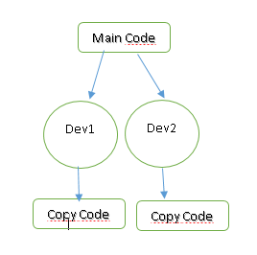
Distributed vs. centralized
DisAdvantages of DVCS
Initial checkout of a repository is slower as compared to checkout in a centralized version control system, because all branches and revision history are copied to the local machine by default.
Additional storage required for every user to have a complete copy of the complete codebase history.

Slide 12
Operations of Contrubutor
CLONE OR COPY | FORK
PULL | PULL
MERGE | MERGE
COMMIT | COMMIT
PUSH | PULL REQUEST –MERGE REQUEST

Slide 13
Git Protocols to transfer data (TCP)
Git uses Local, HTTP, Secure Shell (SSH) and Git
Local→remote repository is in another directory on the same host
$ git clone /srv/git/project.git
HTTP→ Dumb HTTP Smart HTTP ,
SSH
$ git clone ssh://[user@]server/project.git
Git→ listens on a dedicated port (9418) that provides a service similar to the SSH protocol,

Slide 14
Svn Protocols to transfer data (TCP)
svn://repos
svn+ssh://repos
https://repos
http://repos

